Slide 1

NEW

Slide 2
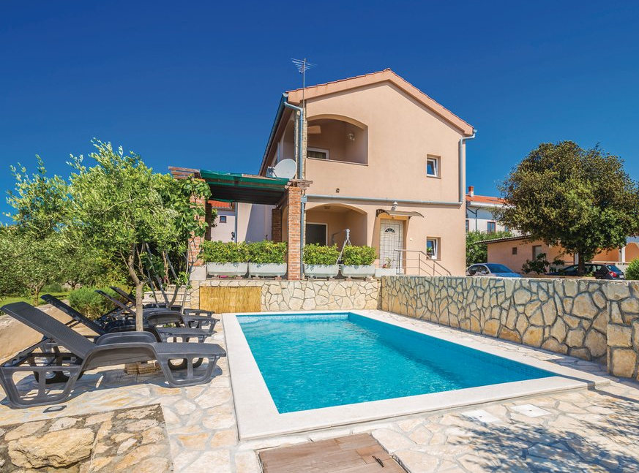
NEW

Slide 3

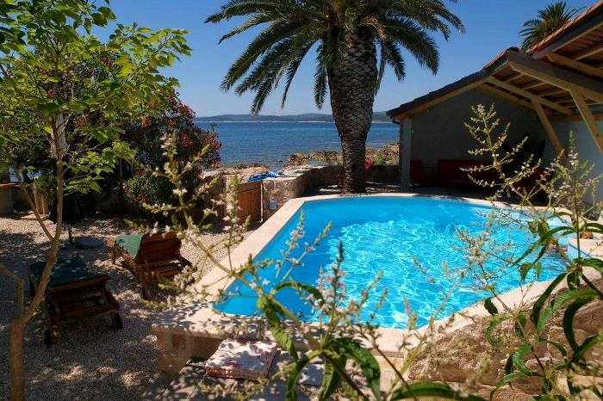

Slide 4

10% OFF

