Slide 1
NEW

Slide 2
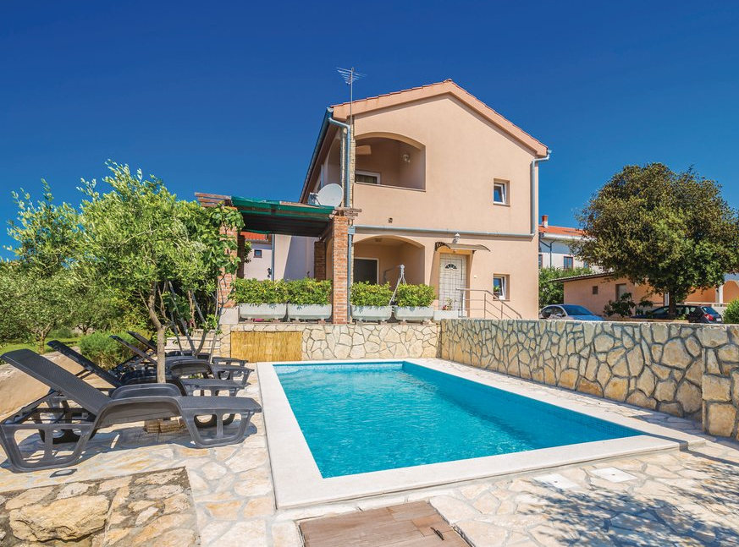
NEW

Slide 3
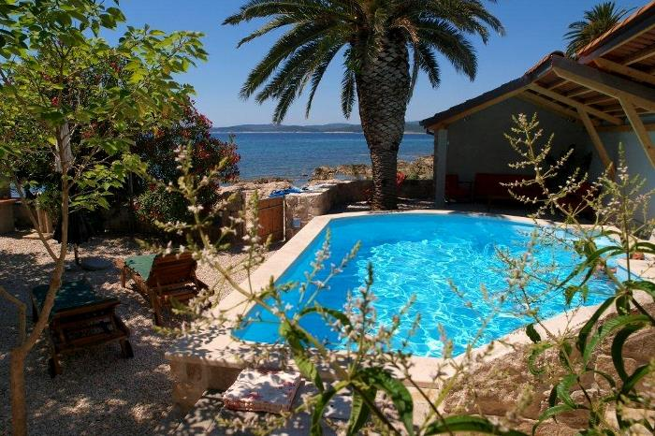

Slide 4
10% OFF

